Slide 1
“Getting Triggy with it!”
Trigonometric Functions & The Unit Circle
Nicole Palmieri

Slide 2
Goals & Objectives
Goal:
Students will investigate and create sine/cosine curves.
Objective:
Given a set of data, students will model/graph how a trigonometric function describes the relationship between a wheel spinning at a constant rate with relationship to the height above the ground with 85% accuracy.
Next Lesson’s Objective:
Given a set of data, students will discover a relationship between the given measure and the period, amplitude, and phase shift of a function with 85% accuracy.

Slide 3
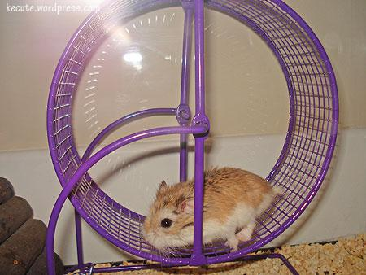
Materials
Hamster wheel
Ruler
Graph paper
Post-its
Pencil/Pen
Worksheets

Slide 4
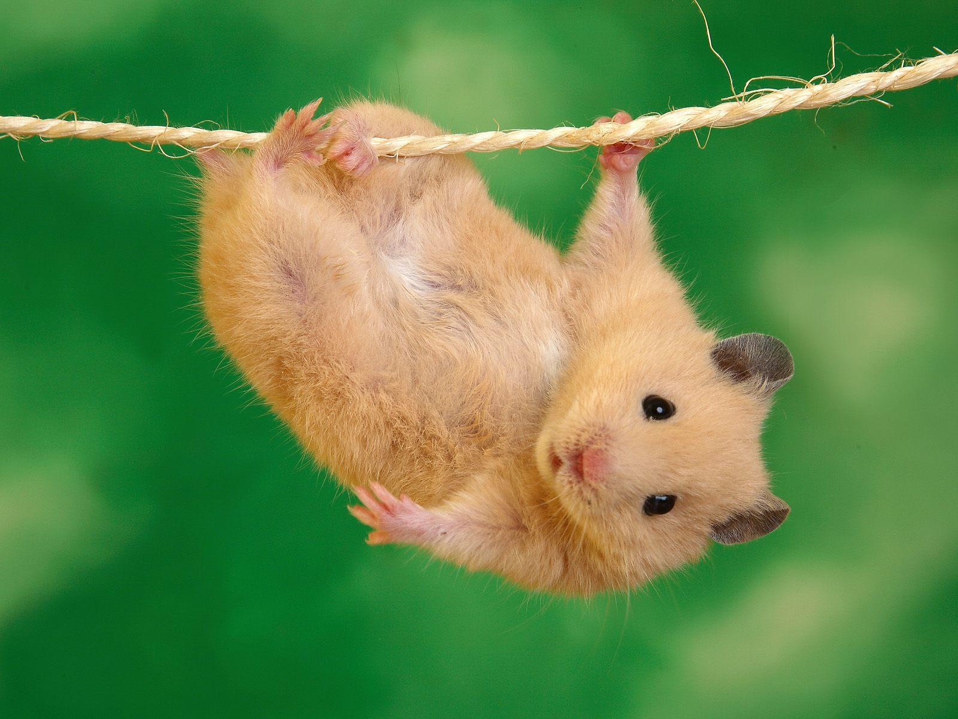
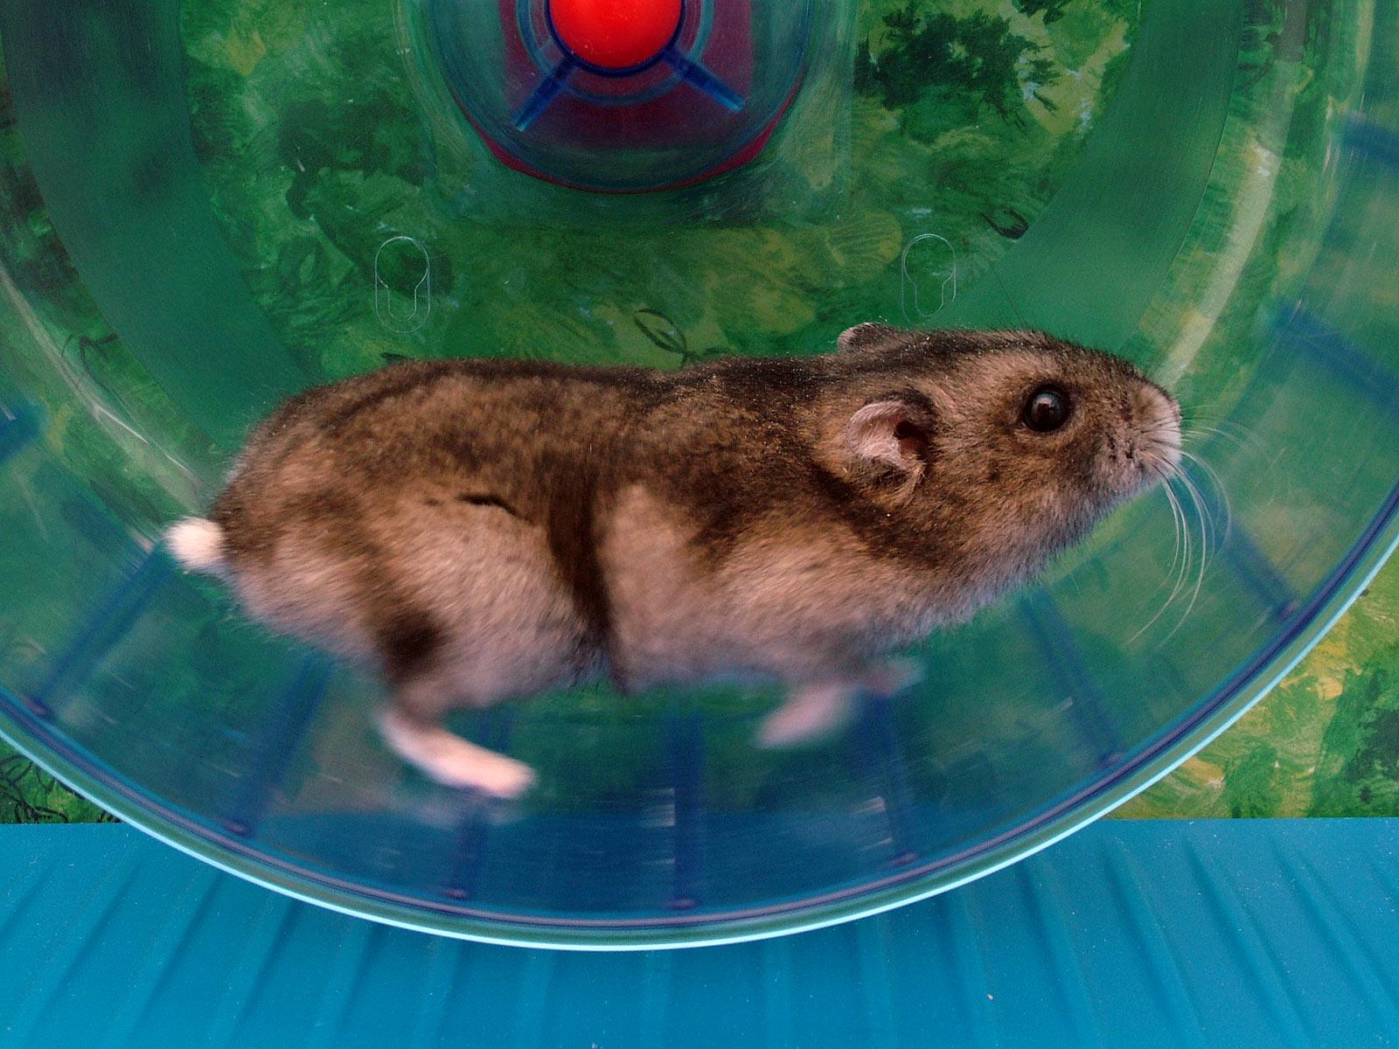
Hamster Wheel Trigonometry

Slide 5
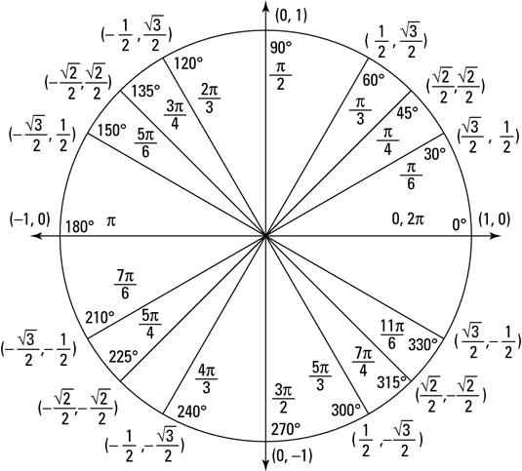
Review: y=Asin(B(x-D))+C, y=Acos(B(x-D))+C
Unit Circle & Quadrants
Amplitude: 1/2|Max-Min|
Period: 2PI/B
C = Vertical Shift
D = Horizontal shift
Frequency: number of cycles it completes in a given interval

Slide 6
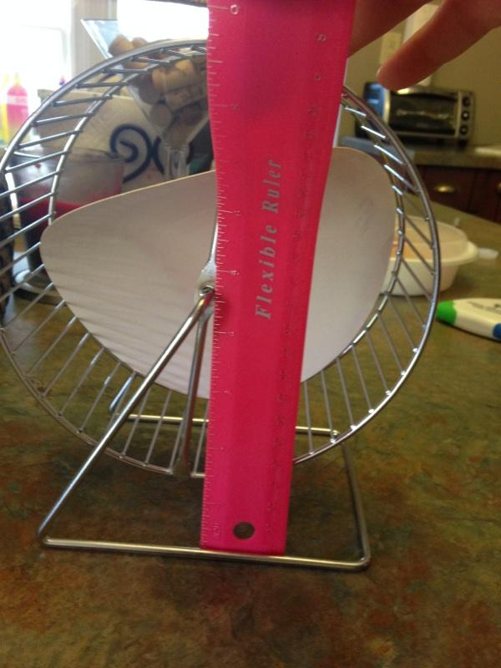
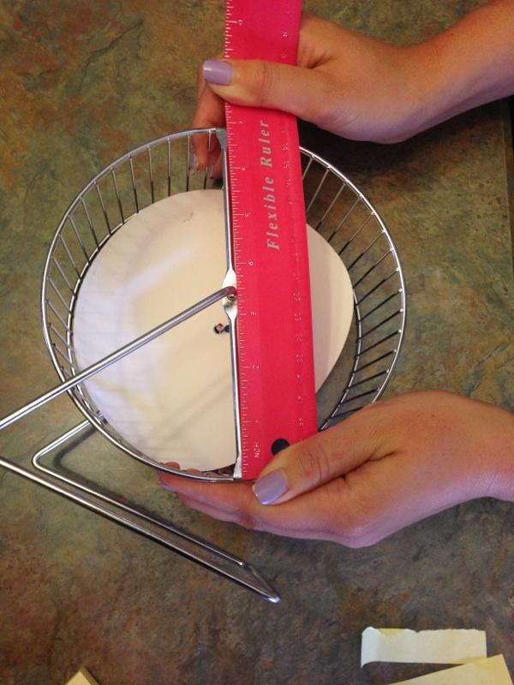
Hamster Wheel Trigonometry
Graph 2 complete periods that models the height of the hamster wheel in relation to time (sec). Use a cosine curve.
Find the diameter of the hamster wheel: 18 cm
Find the distance of the center of the hamster wheel above the ground: 12 cm
Find the distance from the ground to the lowest point of the wheel: 3 cm
Radius=9 cm 12-9=3 cm
Assume 1 full rotation takes 60 seconds

Slide 7
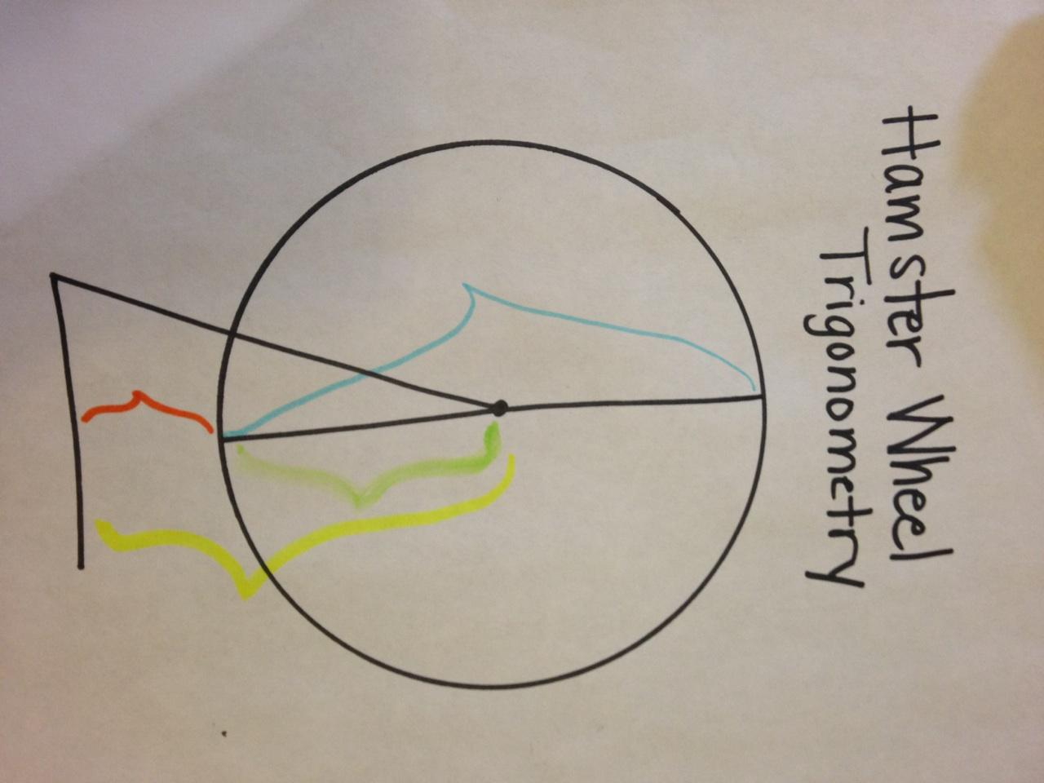
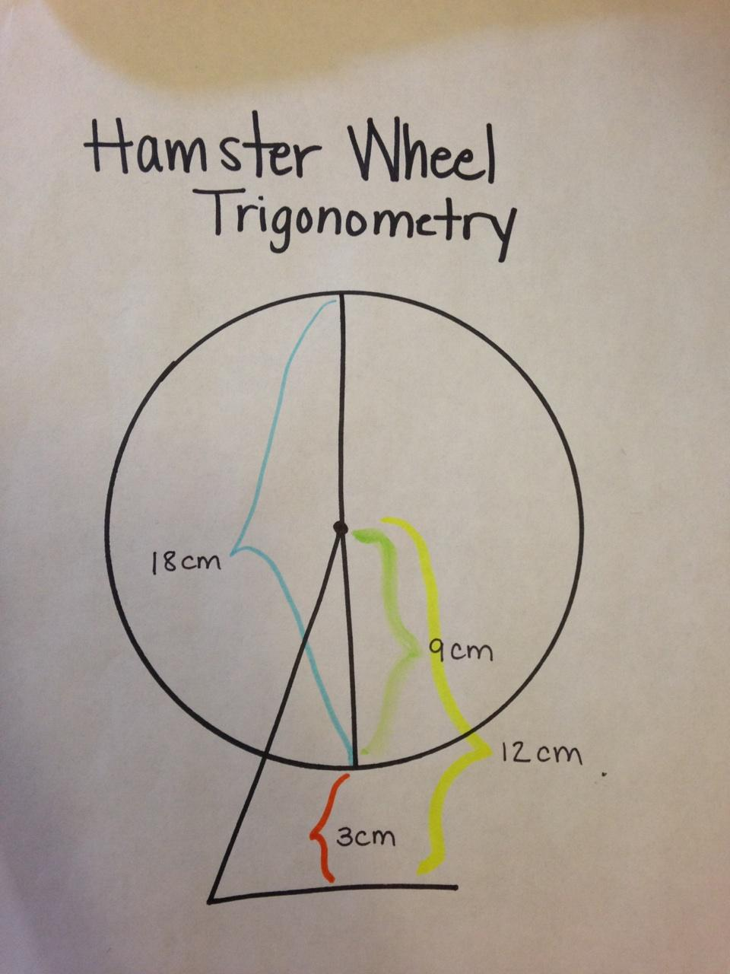
Students will be given this blank diagram worksheet to fill in the information that they discover after measuring the hamster wheel.

Slide 8
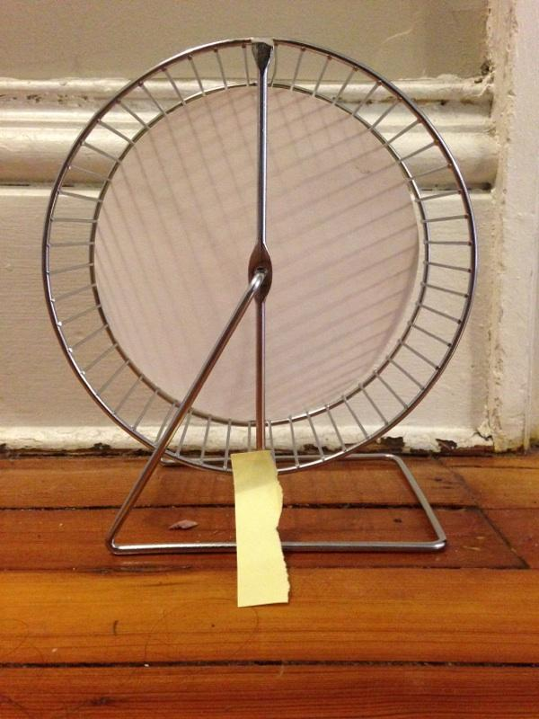
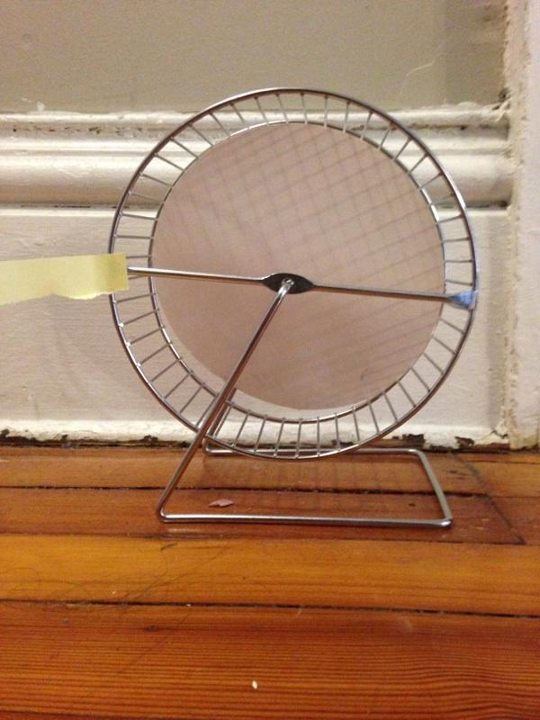
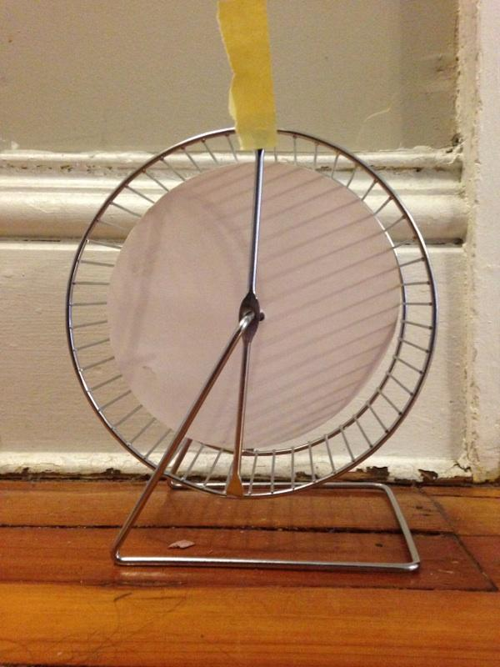
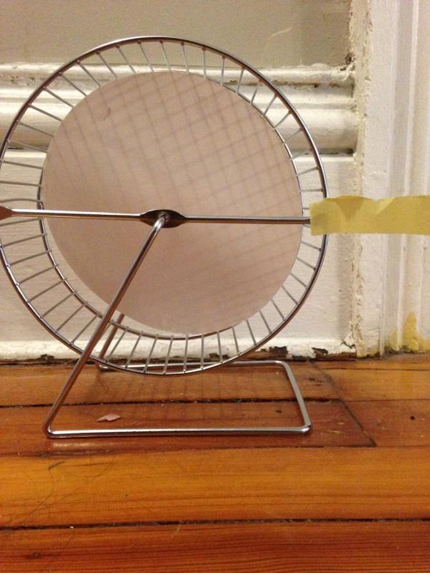
Hamster Wheel Trigonometry
Create four quadrants out of your hamster wheel based on the time and label each section with a post-it. (Relation to Unit Circle*)
0/60 seconds 15 seconds 30 seconds 45 seconds

Slide 9
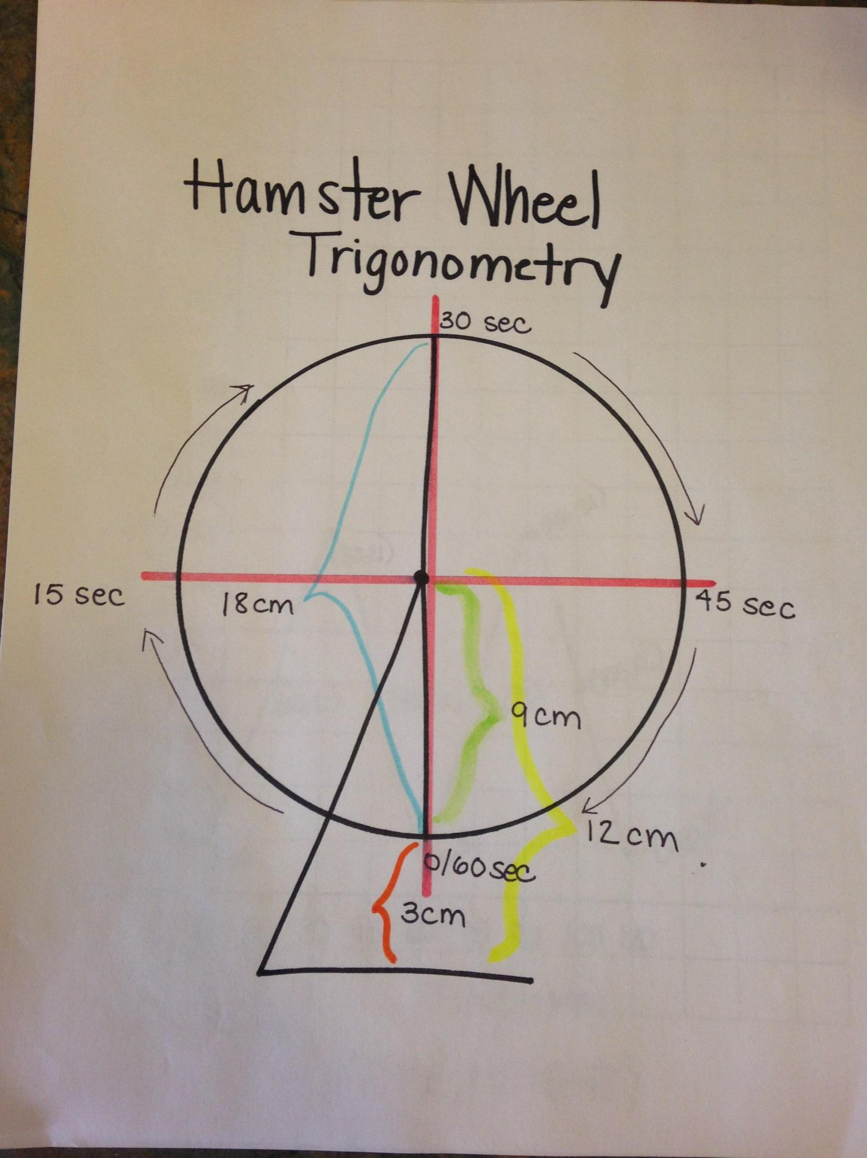
Students will refer back to the diagram worksheet and fill in the time intervals of the 4 quadrants.
0 seconds= 0 rotation
15 seconds= ¼ rotation
30 seconds = ½ rotation
45 seconds = ¾ rotation
60 seconds = 4/4 = 1 full rotation

Slide 10
Students will measure the hamster wheel at each time interval & record their data.
Time (seconds) | Height (cm) | Height above ground (cm)
0 | 0 | 3
15 | 9 | 12
30 | 18 | 21
45 | 9 | 12
60 | 0 | 3
75 | 9 | 12
90 | 18 | 21
105 | 9 | 12
120 | 0 | 3
1 revolution
2 revolutions

Slide 11
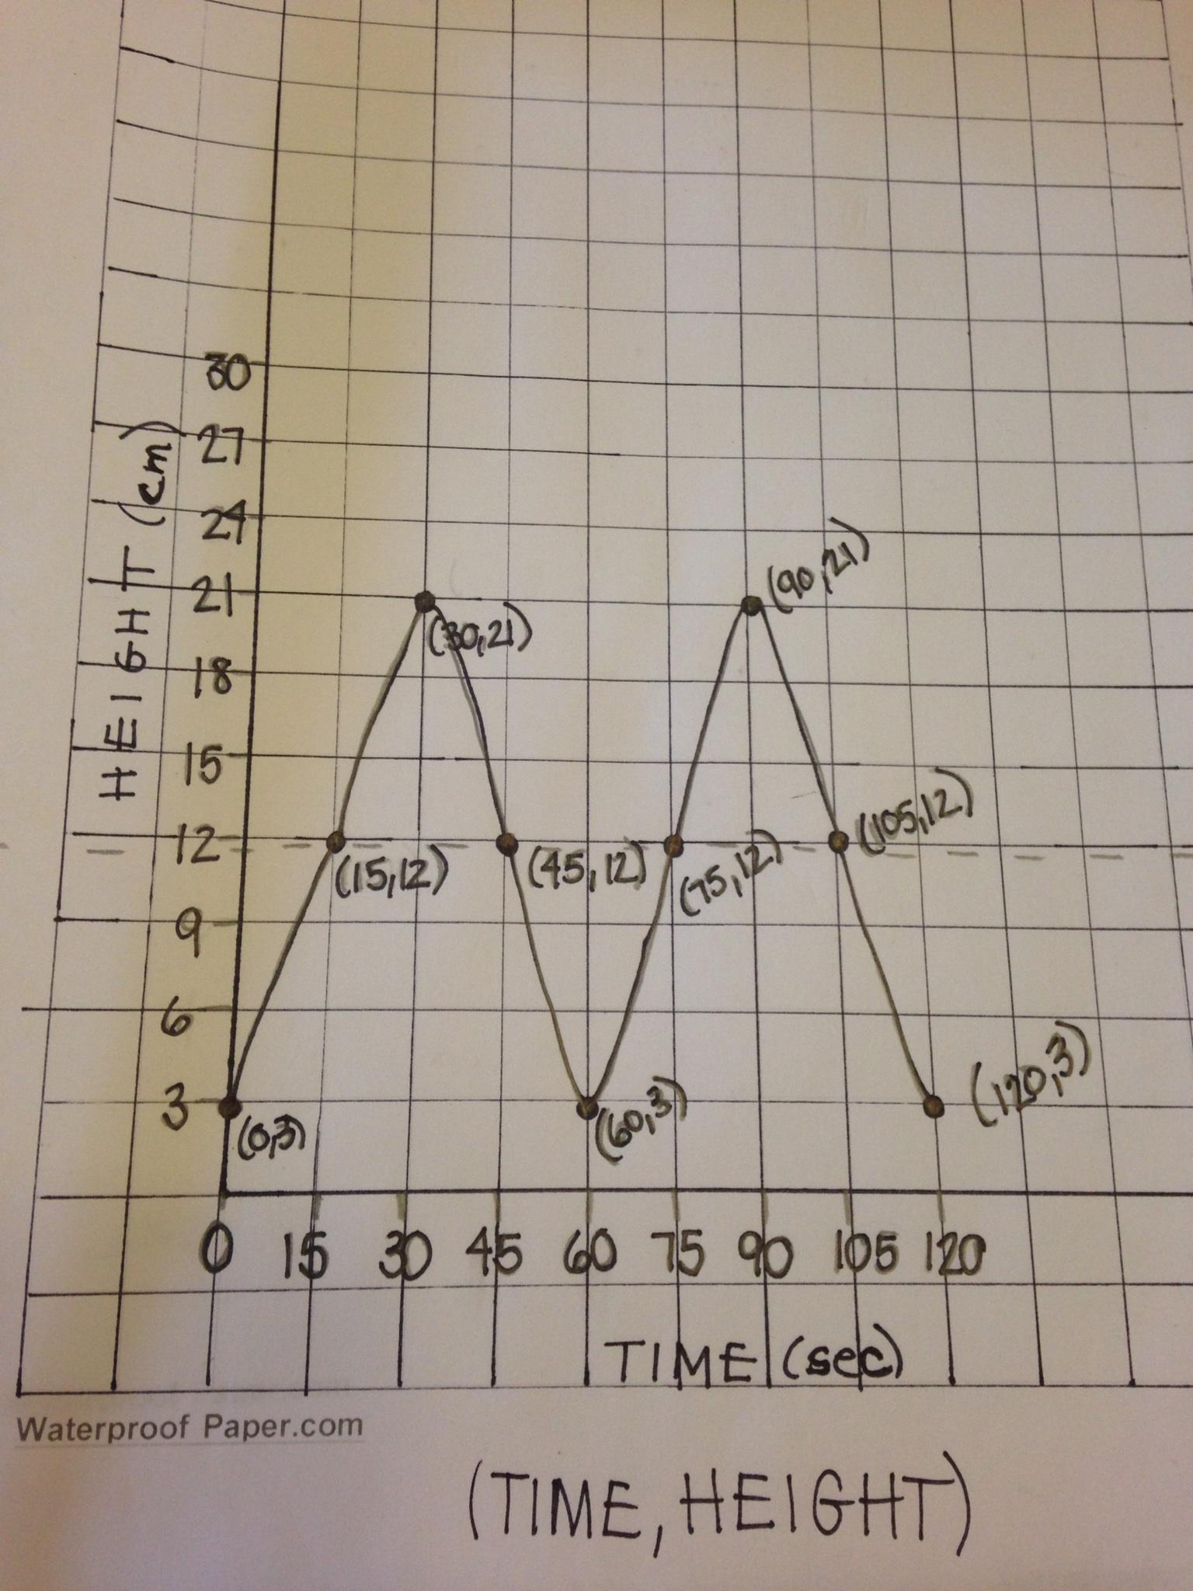
Students will graph the relation between the time and height of the post-its above the ground.
Concluding Questions: What is interesting about your graph?
What is the minimum value?
What is the maximum value?
What is the period of this function?
What is the frequency of this function?
At what point does the curve begin to repeat?
What other real-world experiences could you use trigonometry in?

Slide 12
Bloom’s Taxonomy:
Knowledge: Recall Information on the unit circle
Comprehension: Demonstrate hamster wheel as unit circle
Application: Use and apply knowledge
Analysis: Organization of ideas (Create a table)
Synthesis: Use old concepts to create new ideas (Graphing table turns to cosine curves)
Evaluation: Compare ideas

Slide 13
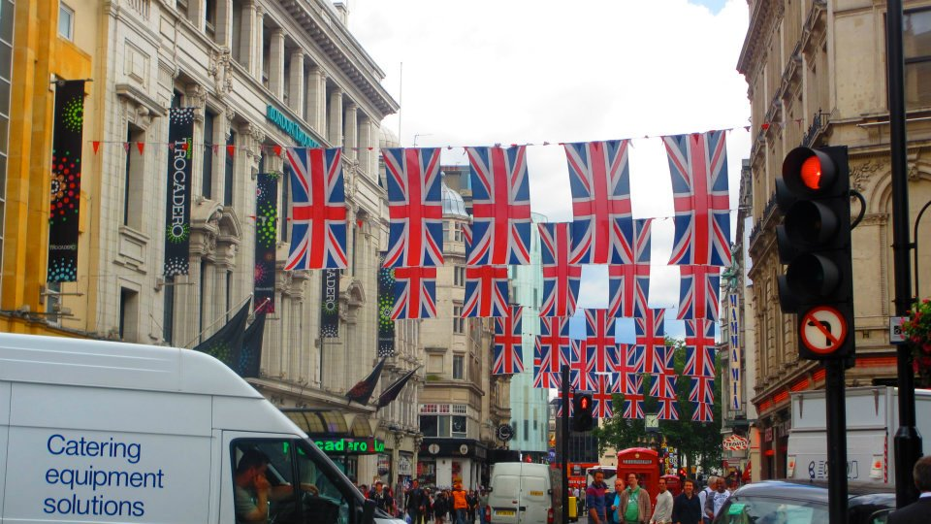
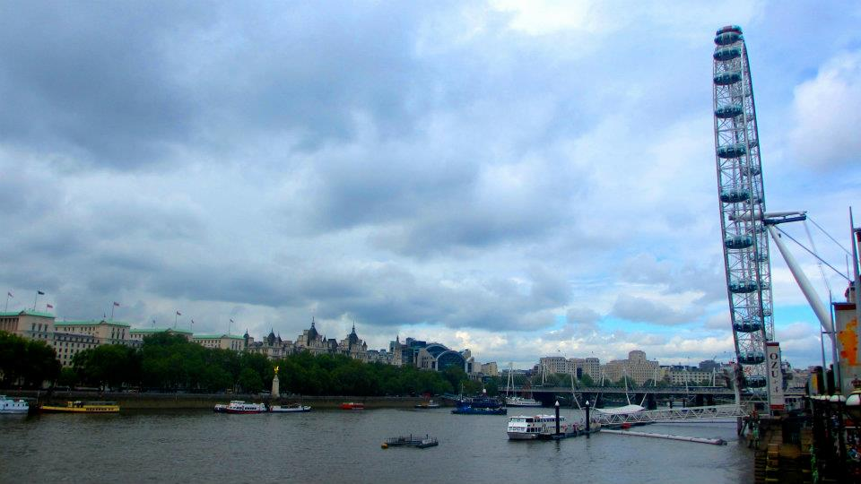
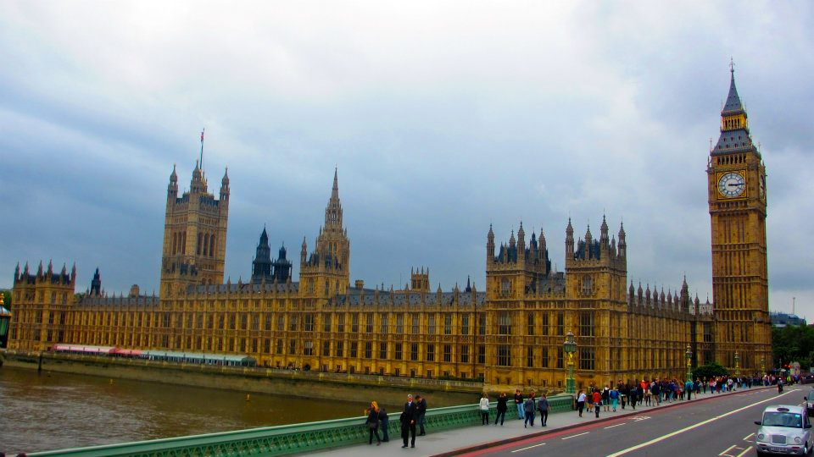
Real Life Experience: Ferris Wheel
The London Eye

Slide 14
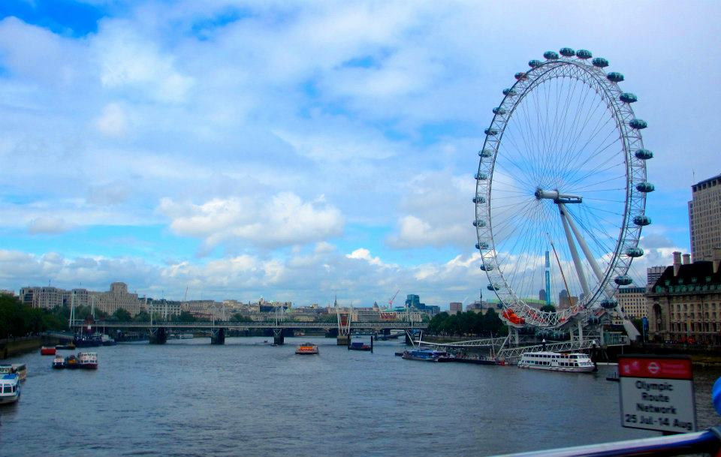
About The London Eye...
An experience on the London Eye will last about 30 minutes.
The London Eye will take you to a height of about 135 metres.
At the top you can see as far as 25 miles.

Slide 15
Sources:
https://www.youtube.com/watch?v=RFkLdiDcJKc

